Slide 1

ABP 7.1 RC Version Released
ABP 7.1-RC2 version released. https://blog.abp.io/abp/ABP.IO-Platform-7.1-RC-Has-Been-Published
This version comes with .NET 7.0.100, Angular 15.0.1
The stable version is planned to be released on March 07, 2023
Notes:
ABP 7.1 rc2 version has been lately released.
Here’s the blog post about this version.
https://blog.abp.io/abp/ABP.IO-Platform-7.1-RC-Has-Been-Published
Check out the blog post to understand how to create a new ABP project with this RC version.
Learn how to migrate from 7.0 to 7.1 and see the changes.
This version comes with .NET 7 and Angular 15.
We’re planning to release the stable version on March 7.

Slide 2
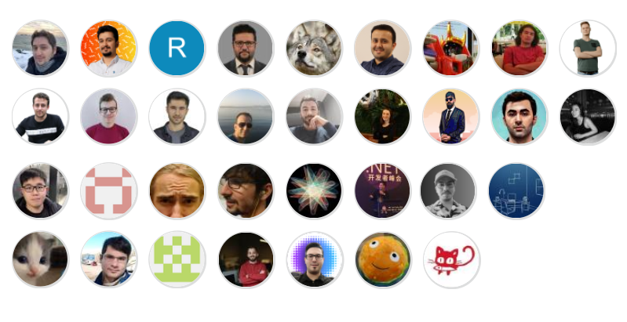
Thanks to the contributors of v7.1
Notes:
This version has been released with 31 contributors.
Thanks to all developers who took part in this version.
Hopefully, ABP v7.1 doesn't introduce any breaking changes.
Every release of ABP includes improvements to performance, quality, stability, and ease of use of the APIs and libraries that make up the active and growing ABP ecosystem.
I will explain these in the next pages.

Slide 3

What’s new with ABP 7.1
Blazor WASM option added to the Application Single Layer Startup Template
Notes:
As you know we have a single layer application template.
And noew we added Blazor WASM into this template.

Slide 4
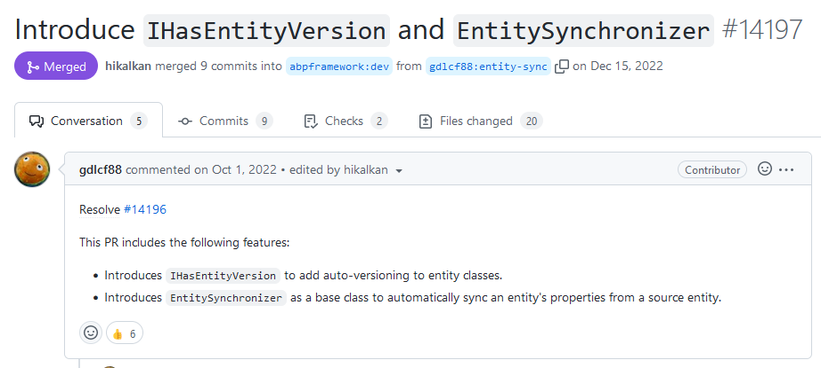
What’s new with ABP 7.1
New interface 👉 IHasEntityVersion New base class 👉🏾 EntitySynchronizer
Notes:
1 new interface and base class came with this version.
gdlcf88 is one of the fans of ABP and making good contributions.
He added;
IHasEntityVersion interface added. This a standard interface for automatic versioning of your entities.
https://docs.abp.io/en/abp/7.1/Entities#versioning-entities
EntitySynchronizer base class. This’s a base class to automatically sync an entity's properties from a source entity.
https://docs.abp.io/en/abp/7.1/Distributed-Event-Bus#entity-synchronizer

Slide 5

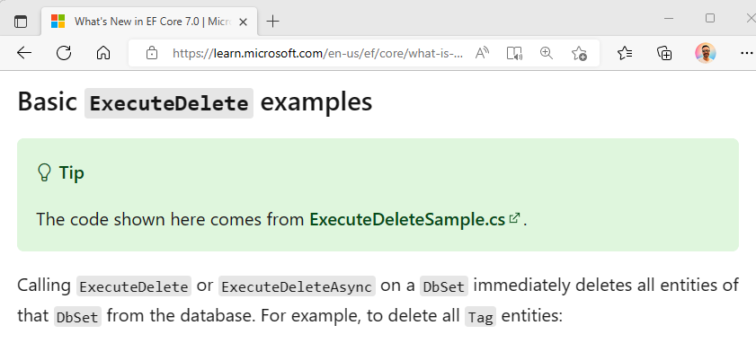
What’s new with ABP 7.1
Support for fast deleting DB records
DeleteDirectAsync()
from EF Core 7.0 documentation
Notes:
EF Core 7 introduced a new method called ExecuteDeleteAsync extension method https://learn.microsoft.com/en-us/ef/core/what-is-new/ef-core-7.0/whatsnew#basic-executedelete-examples This method immediately deletes all entities of a DbSet. This is useful for bulk deletion when you want to delete many rows at the same time.
We added a method corresponding to this method in the ABP Framework.
It’s called DeleteDirectAsync method to the IRepository interface.
It directly deletes entities from database, without fetching them.

Slide 6
What’s new with ABP 7.1
Get hosting environment from
IAbpHostEnvironment
public class LibraryClass
{
private readonly IAbpHostEnvironment _abpHostEnvironment;
public MyService(IAbpHostEnvironment abpHostEnvironment)
{
var isDevEnvironment = abpHostEnvironment.IsDevelopment();
}
}
Notes:
As you know you can use the ASP.NET Core’s IWebHostEnvironment or IWebAssemblyHostEnvironment interfaces in your startup application. But when you want to access this information from a middle project like class libraries, you cannot use these interfaces.
For this purpose we added IAbpHostEnvironment.
This interface helps to get the active hosting environment information like WebRootPath, base address for the application so on.

Slide 7
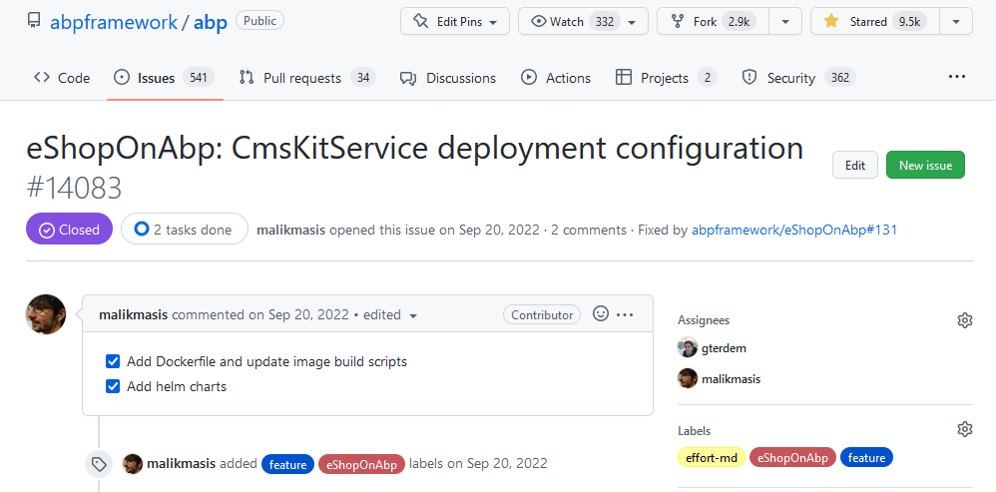
What’s new with ABP 7.1
Improvements on the eShopOnAbp
Notes:
Dockerfiles and helm-charts have been added and image build scripts have been updated on eShopOnAbp project.

Slide 8
What’s new with ABP 7.1
Other features…
Referral Links have been added to CMS Kit comments.
ReCaptcha verification has been added to CMS Kit comments.
Cache durations reduced for the development environment.
Notes:
Referral Links have been added to CMS Kit comments. You can specify common referral links (such as "nofollow" and "noreferrer") for links in the comments.
ReCaptcha verification has been added to CMS Kit comments. You can enable it to protect your comments section against bots.. https://docs.abp.io/en/abp/7.1/Modules/Cms-Kit/Comments#options
ABP provides a caching layer for performance concerns. However, at development time, caching can be disadvantageous. Therefore, the cache durations have been reduced to appropriate times. https://github.com/abpframework/abp/pull/14842

Slide 9
What’s new with ABP Commercial 7.1
Blazor WASM option added to the application Single Layer PRO startup template
abp new TodoApp -t app-nolayers-pro -u blazor --version 7.1.0-rc.1
Notes:
The Application (Single Layer) Startup Template came with v5.2.
And 3 UI frameworks were supported: Angular, Blazor Server, and MVC.
In this version, we've added the Blazor WASM option to the Single Layer Startup template.
It has still 3 projects (Blazor, Host, and Contracts) but hosted within a single host project.

Slide 10

What’s new with ABP Commercial 7.1
Added
MAUI Blazor
code generation support to
ABP Suite
Notes:
We provided a new UI option "MAUI Blazor" for the app-pro template in the previous version
and now it's possible to create a maui-blazor application with both ABP CLI and ABP Suite.

Slide 11
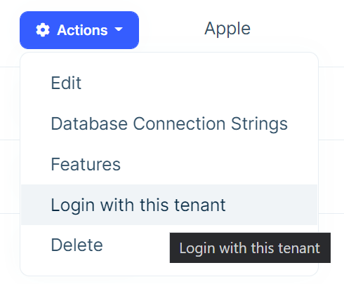
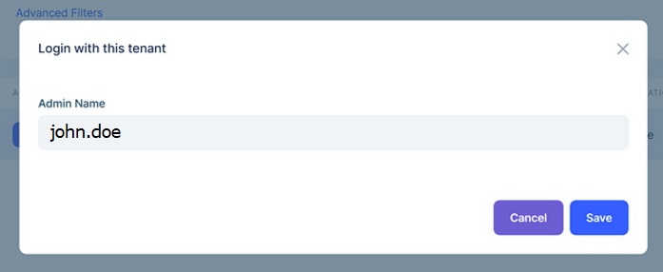
What’s new with ABP Commercial 7.1
Write the username of the target tenant’s user when impersonating
>
Notes:
In previous versions, we were able to impersonate a tenant from the SaaS Module's Tenant Management UI. This approach had a restriction that has been forcing us to impersonate only the "admin" user of the target tenant. With this release, we have allowed to impersonate with any username.

Slide 12
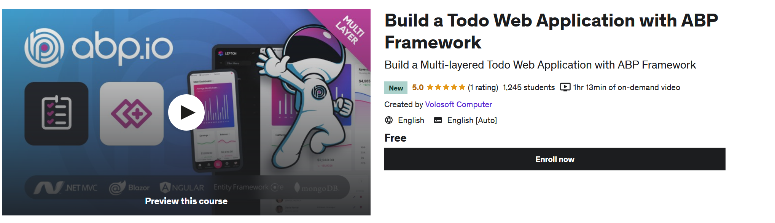
Community Shares
Started free video tutorial series on Udemy by Hamza Albreem
https://www.udemy.com/course/build-todo-web-application-with-abp-framework/
https://www.udemy.com/course/build-a-single-layer-todo-web-application-with-abp-framework/
Notes:
Building a to do application is the easiest way to get started your first ABP application.
And Hamza Albreem started his video series with building to do web application with ABP Framework.
There are 2 versions of these videos:
With multi-layer architecture and single layer application.
You can enroll these courses on Udemy and learn how to start your first application on top of ABP Framework.
* Multi-layer:
https://www.udemy.com/course/build-todo-web-application-with-abp-framework/
* Single-layer:
https://www.udemy.com/course/build-a-single-layer-todo-web-application-with-abp-framework/
Besides, Hamza started another video tutorial series.
It’s called ABP Framework Fundamentals.
He will explain the most important topics that can be considered the heart of the ABP Framework.
And it’ll also be published as free on Udemy.

Slide 13
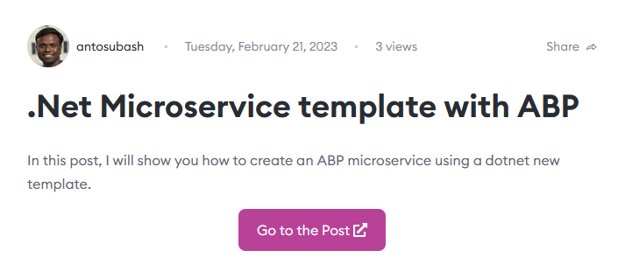
Community Shares
https://community.abp.io/posts/.net-microservice-template-with-abp-53r52ryy
Notes:
Anto Subash created a .NET microservice template based on open-source ABP modules.
In this article he shows how to create an ABP microservice using his new dotnet template.
https://blog.antosubash.com/posts/dotnet-microservice-template-with-abp

Slide 14

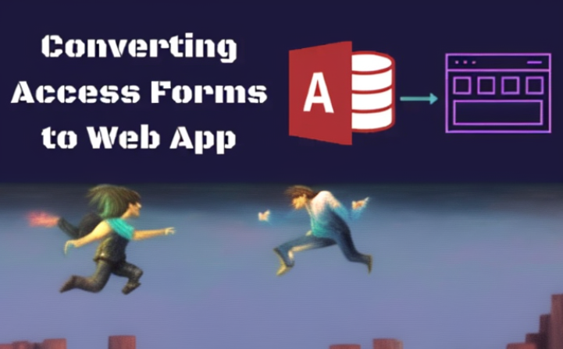
Community Shares
Why ABP Framework is one of the best tools for migration
from legacy MS Access systems to latest Web app
https://community.abp.io/posts/why-abp-framework-is-one-of-the-best-tools-for-migration-from-legacy-ms-access-systems-to-latest-web-app-7l39eof0
Notes:
Sergei Gorlovetsky submitted 3 articles.
Migrating legacy MS Access systems to the web platform can be a challenging task for many organizations.
Sergei is explaining the benefits of the ABP Framework when transforming your legacy application to the latest software technology.

Slide 15
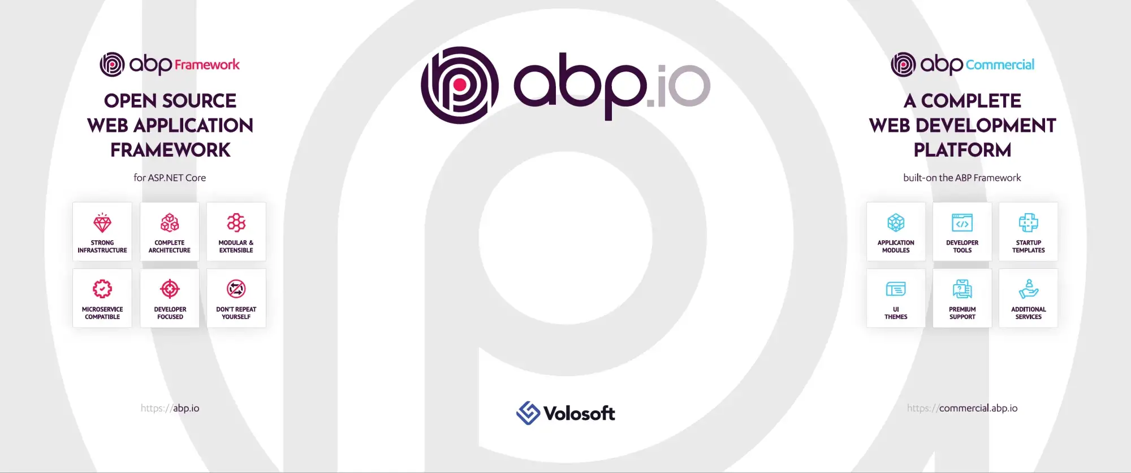
Community Shares
ABP Framework — 5 steps Go No Go Decision Tree
https://decision-tree-technology.medium.com/abp-framework-5-steps-go-no-go-decision-tree-2f5ffc3f543d
Notes:
This article will help you to decide whether or not the ABP Framework is the right choice for your next .NET project.

Slide 16
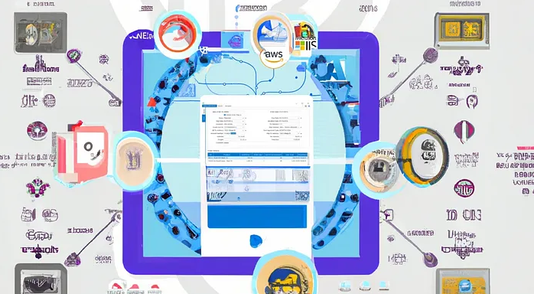
Community Shares
Migration of legacy Power Builder systems to latest Web platform with ABP Framework
https://community.abp.io/posts/migration-of-legacy-power-builder-systems-to-latest-web-platform-with-abp-framework-pxyypj85
Notes:
Explaining how ABP Framework offers a way to migrate from PowerBuilder to the latest web-based regarding scalability, flexibility, resilience, deployment speed, and testing efficiency.

Slide 17
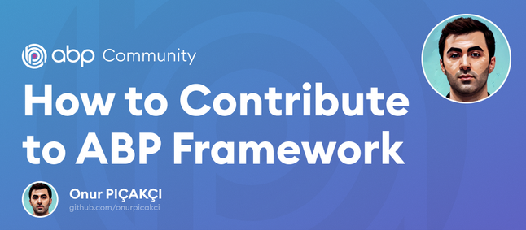
Community Shares
How to Contribute to ABP Framework
https://community.abp.io/posts/how-to-contribute-to-abp-framework-46dvzzvj
Notes:
Onur Pıçakçı submitted his first article to the community platform.
In this article, he explains how you can contribute to the open-source ABP Framework.
You will also learn how to contribute to an open source project, what are the standard rules, some git operations, etc.

Slide 18
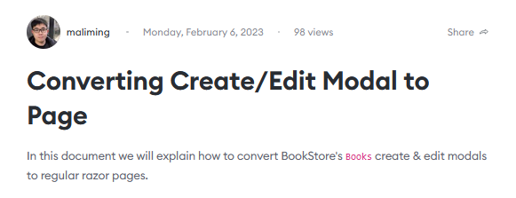
Community Shares
Converting Create/Edit Modal to Page
https://community.abp.io/posts/converting-createedit-modal-to-page-4ps5v60m
Notes:
Maliming shows how to switch from modals to normal Razor Pages for create and update operations on a bookstore sample project.

Slide 19
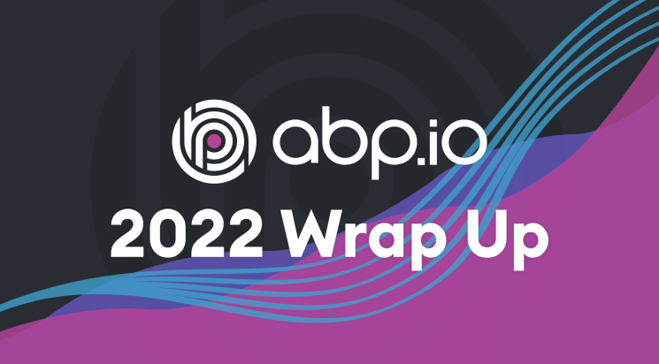
What we did in 2022
https://blog.abp.io/abp/ABP-Year-Review-2022-Wrap-Up
Notes:
In this blog post, we'll take a closer look at the key highlights of 2022 for ABP Framework, from major updates to achievements and the community insights. We are excited to share our progress with you and provide insights into how ABP Framework is helping .NET developers daily life.
https://blog.abp.io/abp/ABP-Year-Review-2022-Wrap-Up

Slide 20
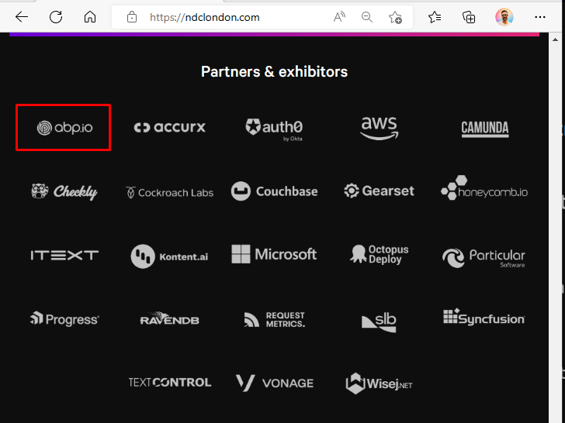
ABP at NDC London 2023
Notes:
We as ABP.io, sponsored NDC London 2023 (twenty-twenty-three), which is the most cosmopolitan developer conference in the center of Westminster, London, UK

Slide 21
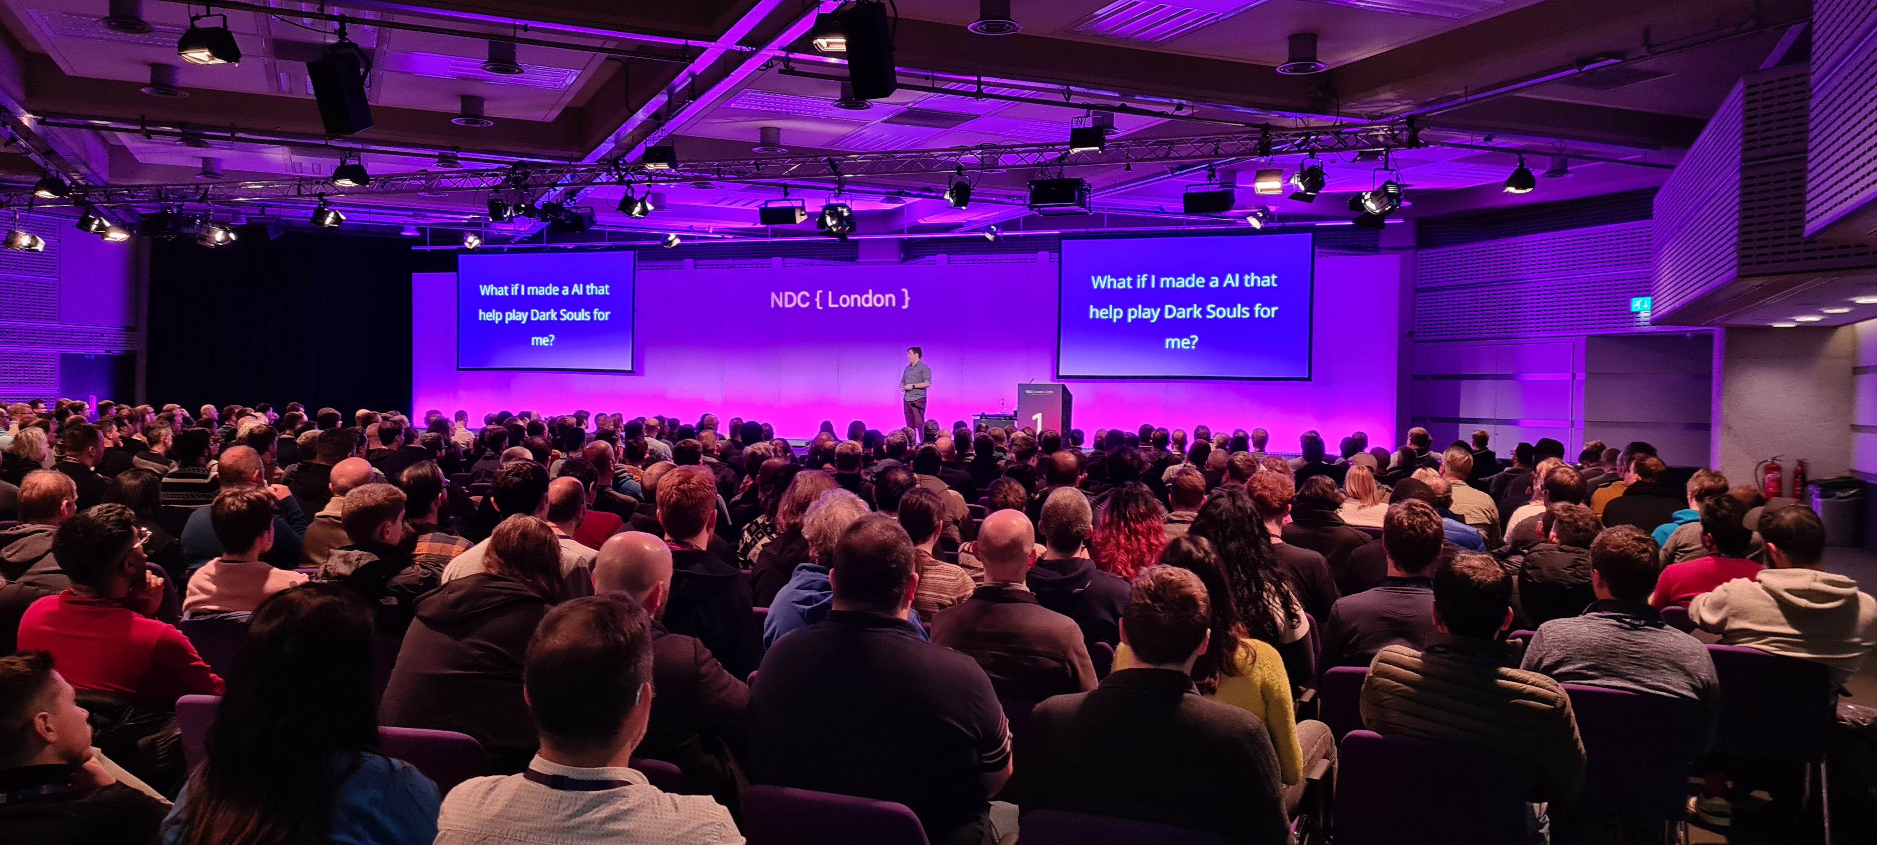
ABP at NDC London 2023
Notes:
The NDC conferences feature a mix of practical hands-on workshops, in-depth technical sessions, and inspiring keynote speakers, and they attract a diverse group of attendees, including developers, managers, and thought leaders from a variety of industries.

Slide 22
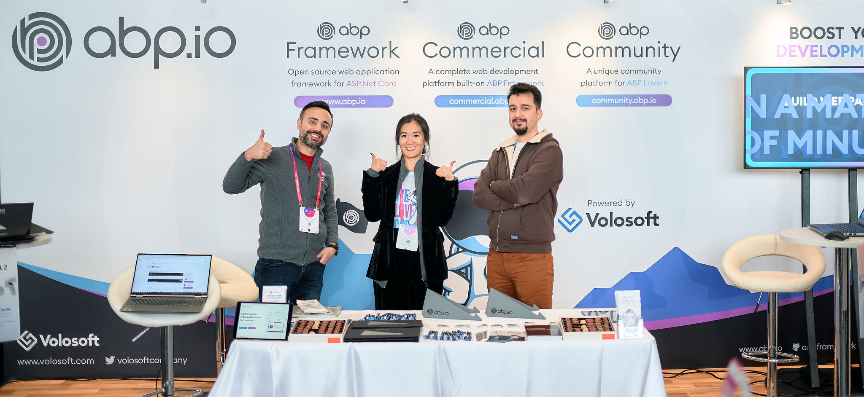
ABP at NDC London 2023
Notes:
We met so many enthusiastic developers from around the globe.
It was great to see that the attendee count is back to before pandemic conditions.

Slide 23
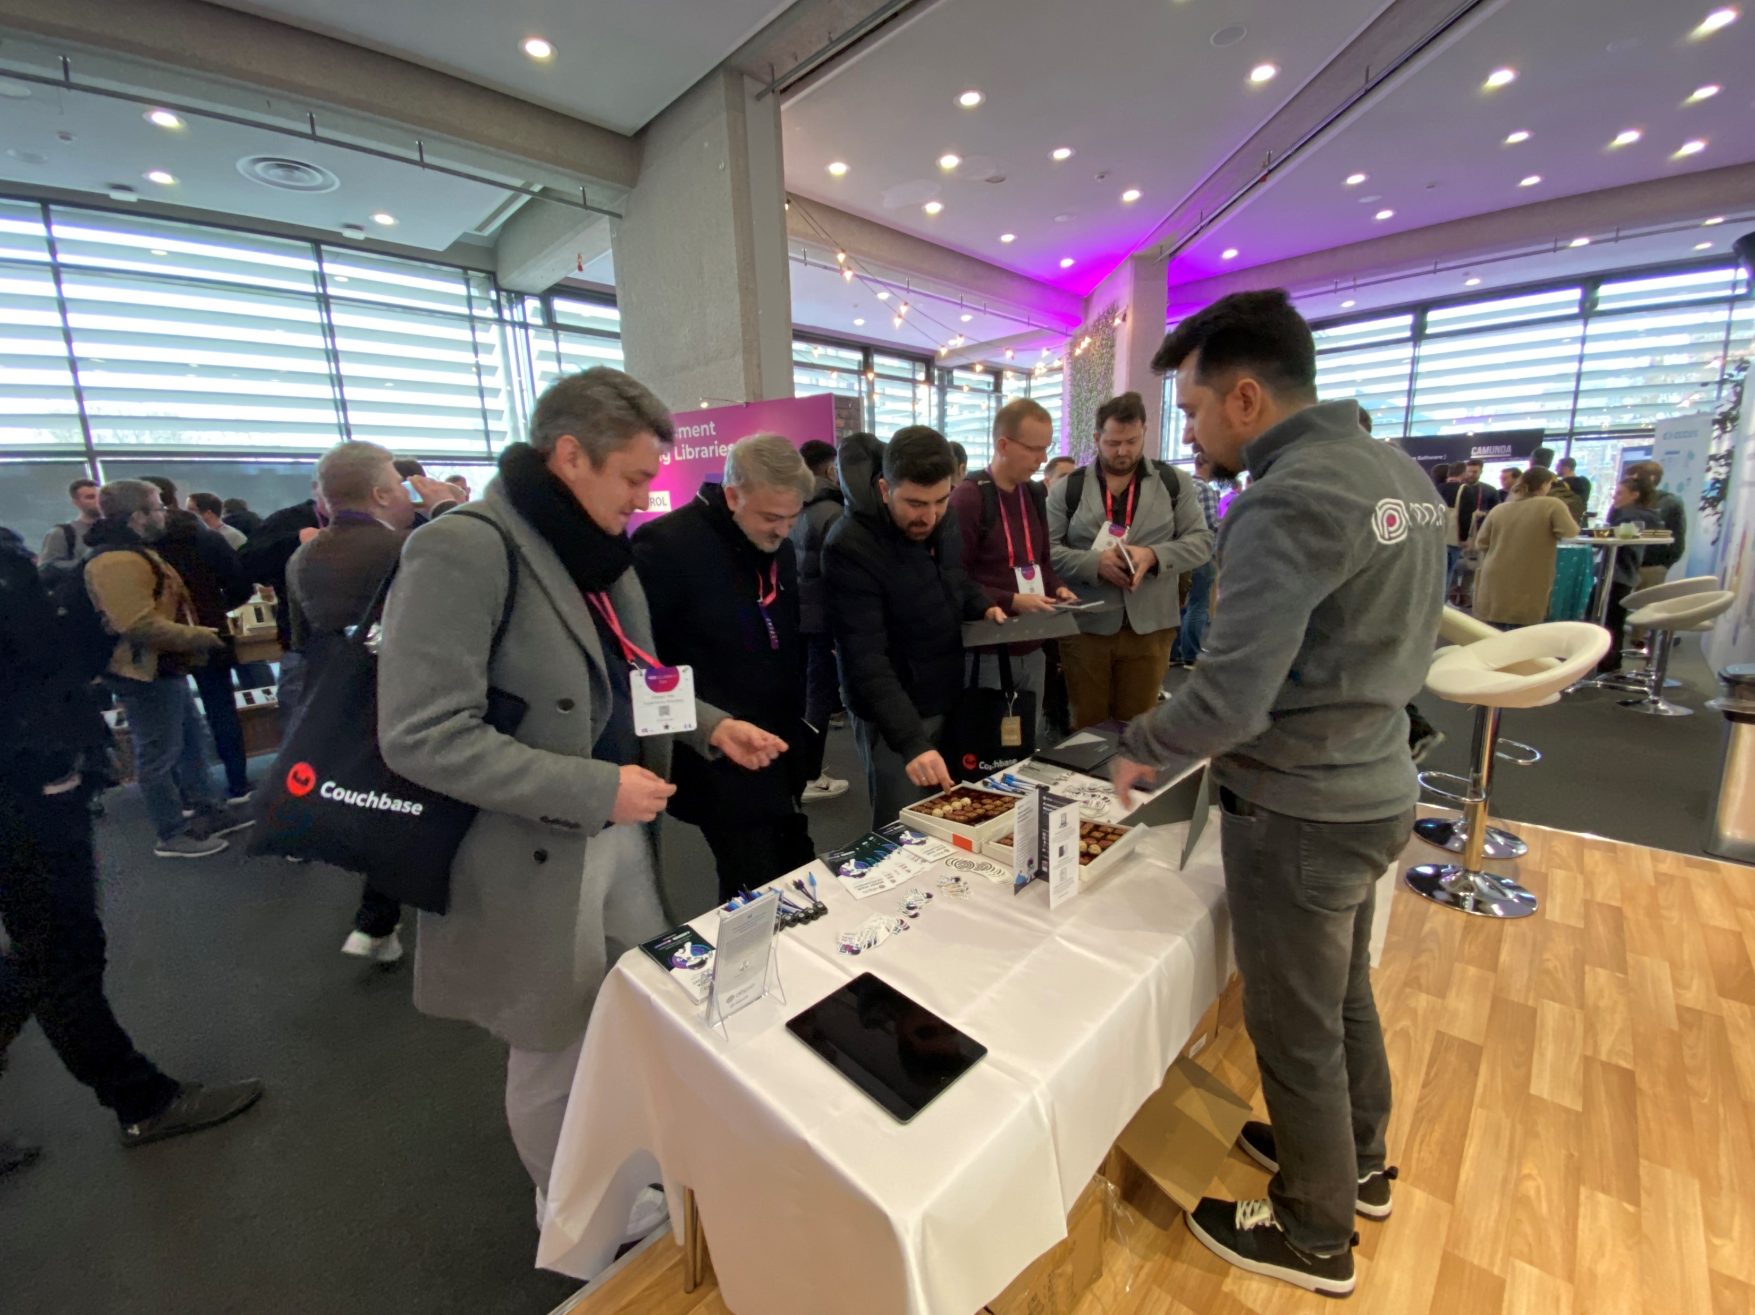
ABP at NDC London 2023
Notes:
Some of the developers already know ABP and they mentioned about what they built with ABP.
Some of them have not heard about it. When they hear the capabilities of the framework, they were ready to use it on their next .NET web project.

Slide 24
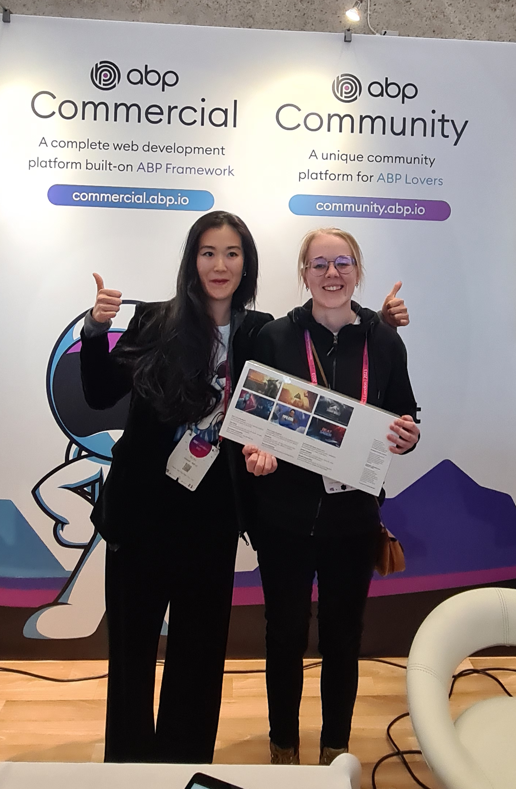
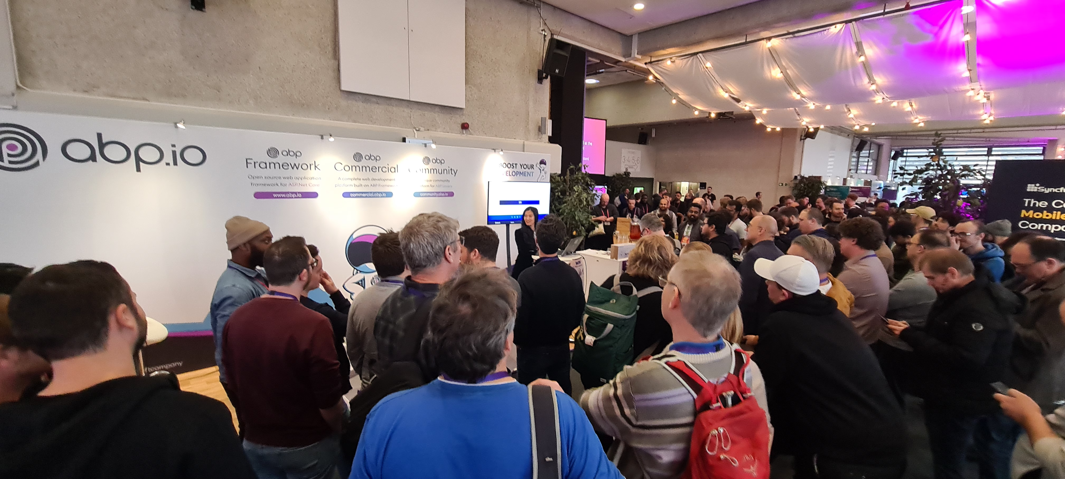
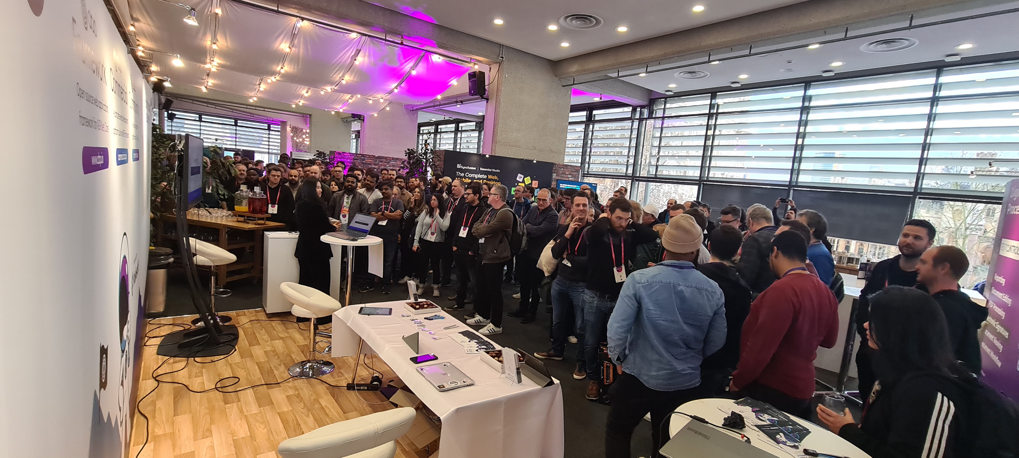
Notes:
We made a raffle on our booth and gave a Meta Quest 2 virtual reality headset.
So that’s all from me!
Please try ABP v7.1 RC and provide feedback to help us make this version as stable as it is.
Thanks for being a part of this community!

